Slide 1
All in one Fitness
The one stop shop for all of your Fitness needs

Slide 2
Functionality
Injury Prevention
Injury care
Workouts and Workout Parameters
Proper Form
Dieting
Stimulants
General Fitness

Slide 3
Injury Prevention
Warm-up
Cool Down
Posture
Daily Stretches
Yoga
Central Nervous System

Slide 4
Injury Care
Where/What/When/How
Types of injuries
Modalities
Stretching
Strengthening
Rest

Slide 5
Workouts and Workout Parameters
Muscle Building vs Power
Weight vs speed
Rest time
Types of exercises
Functional Training
Cardiovascular Training
Weight Loss Training
When to Workout
Sport Specific Excercises

Slide 6
Proper Form
Lifting Form
Running Form
Differences of lifting forms

Slide 7
Dieting
General Healthy Foods
Paleo
Fasting
Keto
When to eat
Everyone's Different

Slide 8
Stimulants
Caffeine
Nicotine
L-Theanine
Lion’s Mane
Mushrooms
Many more…

Slide 9
General Fitness
What everyone should be doing everyday
Lift an X amount
Cardio an X amount
Dieting
Outdoors
Friends/family
Combating Depression

Slide 10
Functional Requirements
Users will have access to a in-depth description and specifying certain injuries.
Users will be able to have specific information on workout and workout strategies.
Users will be able to have information on the proper form of specific workouts.
Users will have access to dieting tips.

Slide 11
Technical requirements
Cross-brower support (Firefox, Chrome, Safari)
Mobile Support (for advanced smartphones – iPhone, Ipad, Android)

Slide 12
Usability Requirements
The system will be fully functional with web browser
The system will be a fully functional phone application

Slide 13
Project Constraints
Time Constraints: System needs to be ready for testing May 2019
Cost Constraints: All services are limited to one programmer who is supporting all library web applications and is also working on multiple simultaneous projects with competing priorities.

Slide 14
User Story
As a overweight man I want to lose weight so that I can see my grandchildren
As a BJJ competitor I want an edge over my opponents so that I win in tournaments.
As a student I want to run faster so that I can join the military.
As a construction worker I want to get rid of pain in my ankle so that I can work and not be fired.
As a high school athlete I want to be more powerful so that I can play football in college for UT and then Cowboys because they are better even though I’m from San Diego.

Slide 15
Use Cases
Actor says hip hurts, system asks when, actor chooses when walking. System asks “what part of the walk?”, actor chooses “toe off” visual. System asks what kind of pain is it, actor chooses dull pain. System gives “hip stretch exercise”. Actor performs hip stretch the recommended amount of times and for the recommended amount of time. The actor’s hip pain goes away when walking.
Actor wants to know the best exercise for getting bigger. The system asks where the user wants to grow, the user select chest. The system gives bench press, supine dumbbell fly’s, and dumbbell bench with the recommended amount of rep’s and proper form for each exercise.

Slide 16
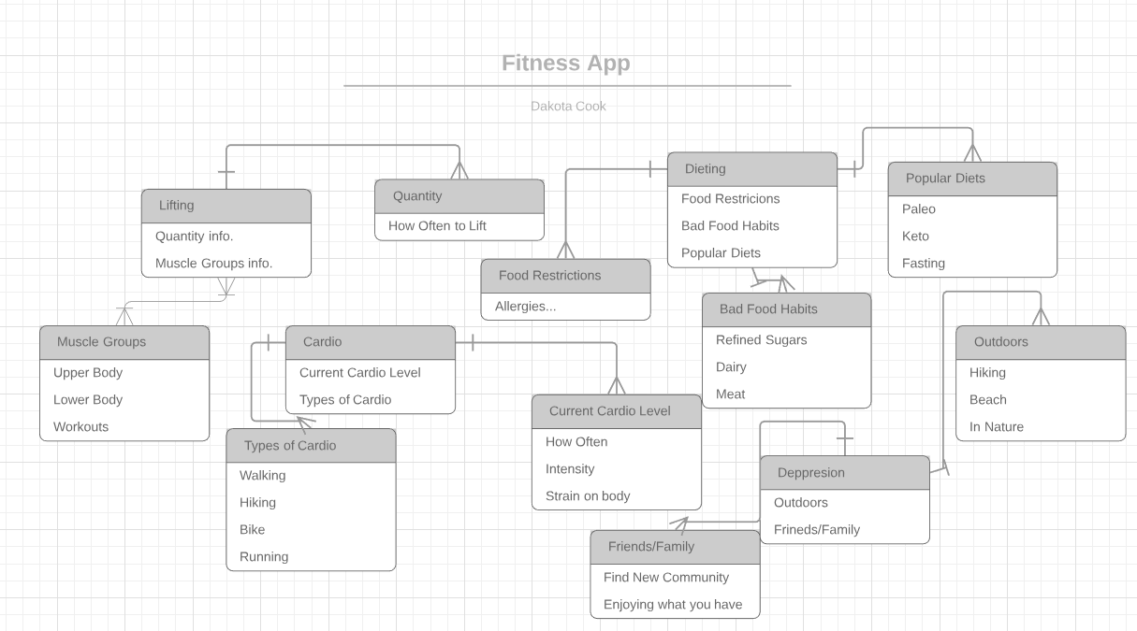
ERD

Slide 17
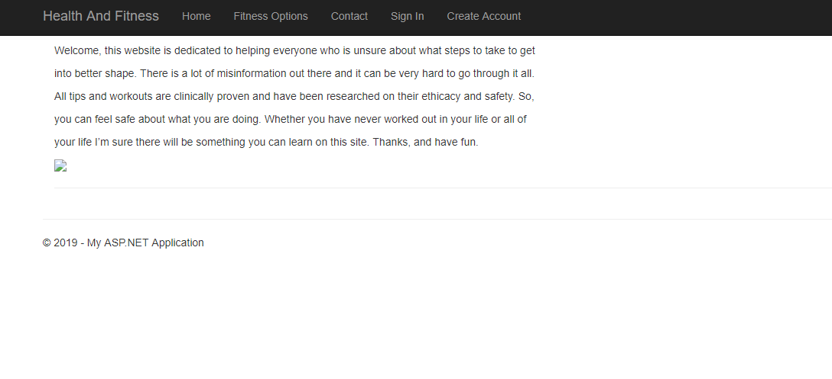
Home Page

Slide 18
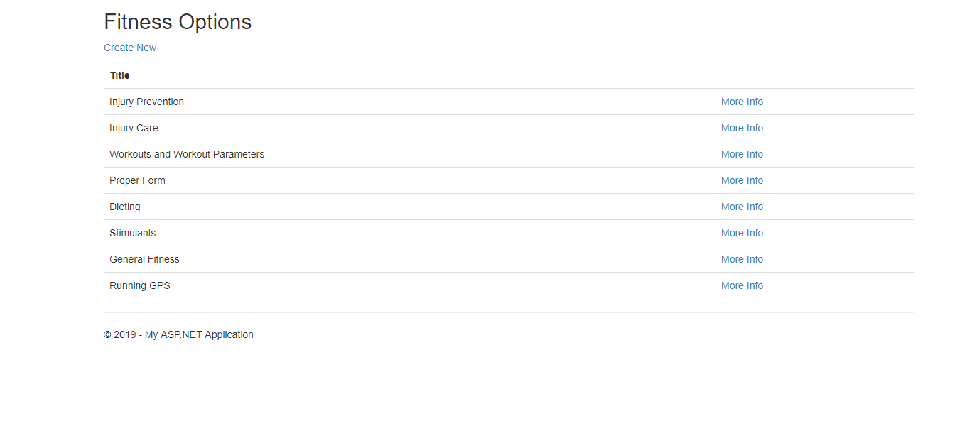
List of Available Options

Slide 19
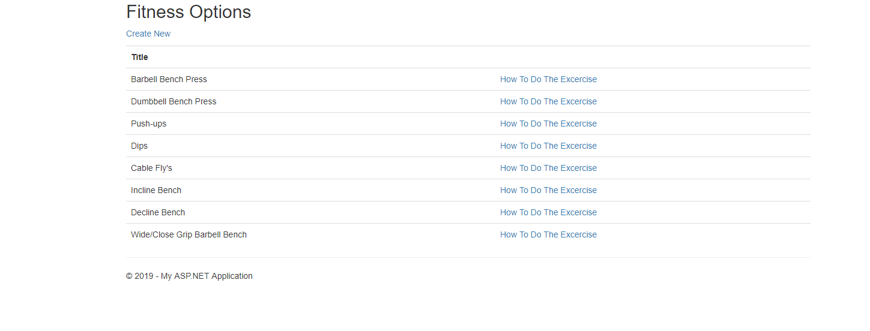
The Workout Option

Slide 20
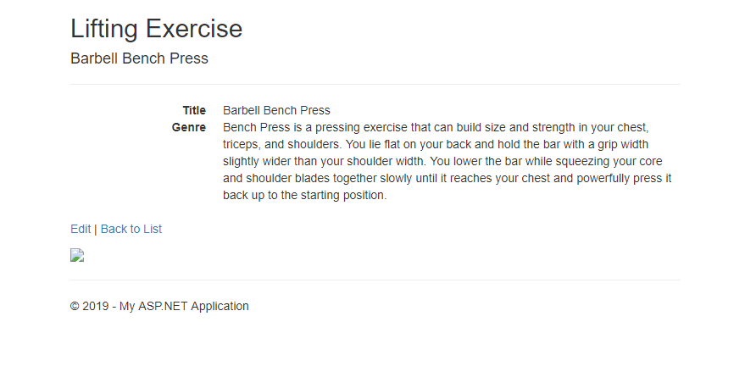
The Bench Press Option

